Slide 1
Crime in Chicago
Safest Places

Slide 2
Our Client
Notes:
This part is for the professor to refresh his memory and does not want to go back to the other document

Slide 3

Our Client
Our client are families with school aged children looking for a the safest area to live and safest area to send their children to go to school in Chicago, Illinois.
This family may be moving into the big city or already living in the city and wants a safer area to live.
Notes:
This part is for the professor to refresh his memory and does not want to go back to the other document

Slide 4
Problem

Slide 5
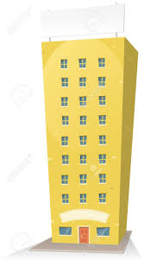

Problem
Safest Residential Areas
In addition to finding a school in a Chicago ward with the crime, we will also identify the ward which you may consider to have your home in, should you wish to live in a ward outside of the best school ward.
Safest Schools Areas Chicago, like any city, is not immune to crime. However, crime is not uniform over the city. We will help you identify the schools in Chicago where you will likely experience the least amount of crime.

Slide 6
Benefits
Notes:
Benefits of the client coming to us

Slide 7

Why we care?
With our analysis we will find you the safest places in Illinois, Chicago for your family and children
We understand the importance of raising a child in a safe environment to help them focus on the learning skills so they can succeed in their education and their future
“It takes a village to raise a child” - Our motto

Slide 8
Plan

Slide 9
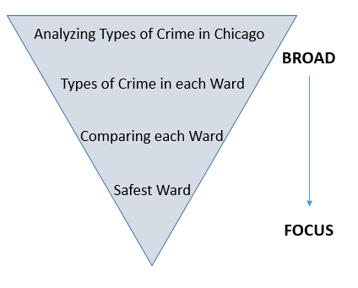
Our Diagnostics
We analyzed the history of various crimes in Chicago to predict future outcomes .
Once we understood the crime in a broad perspective we narrowed it down to wards where we compared the type and amount of crime in each ward against each other to identify which areas has been historically the safest, and which ones will be the safest in the future.

Slide 10
History

Slide 11
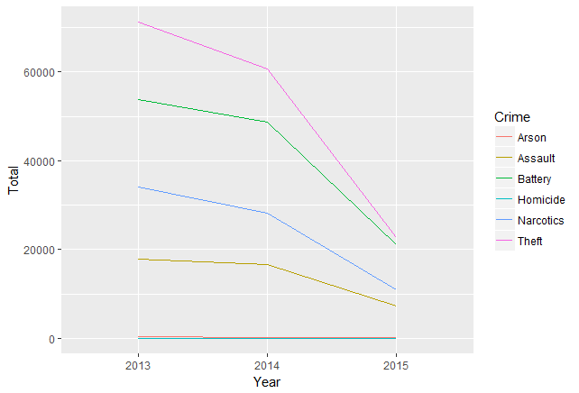
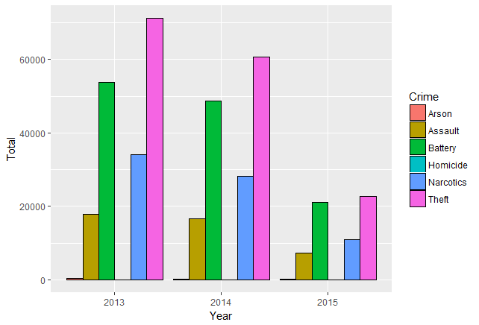
Overall Crime rate in Chicago [2013- 2015]
The crime rate in chicago overall is decreasing from 2013 - 2015.
The two most common crimes in Chicago is Theft and Battery.

Slide 12
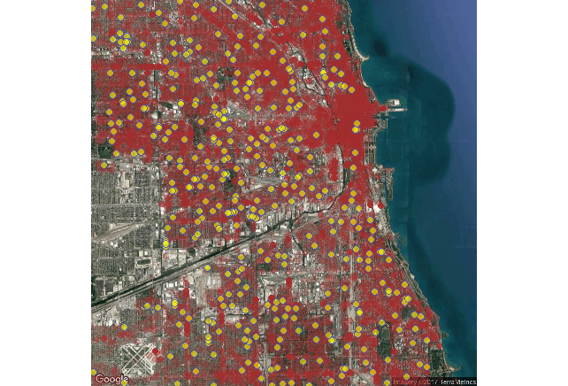
Total Theft Crimes in Chicago
This demonstrates the amount of theft around the various schools
Red = Theft Crimes
Yellow Dots = Schools

Slide 13
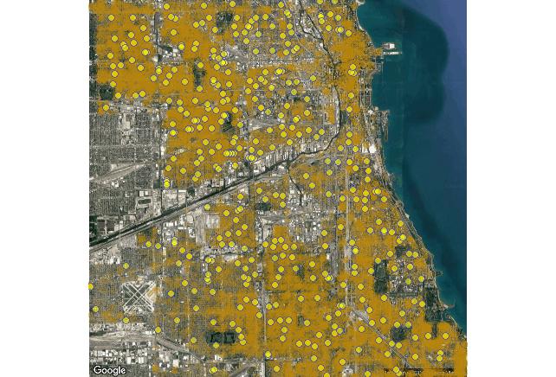
Total Battery Crimes in Chicago
This demonstrates the amount of Battery around the various schools
Yellow Shade= Battery Crimes
Yellow Dots = Schools

Slide 14
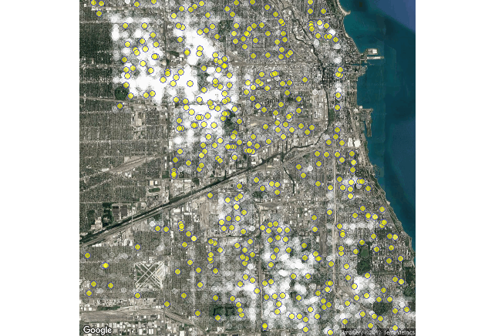
Total Narcotics Crimes in Chicago
This demonstrates the amount of narcotics crime around the various schools
White Shade= Narcotics Crimes
Yellow Dots = Schools

Slide 15
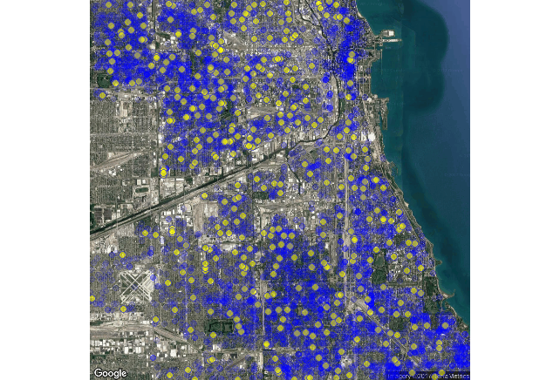
Total Assault Crimes in Chicago
This demonstrates the amount of assault crime around the various schools
Blue Shade= Assault Crimes
Yellow Dots = Schools

Slide 16
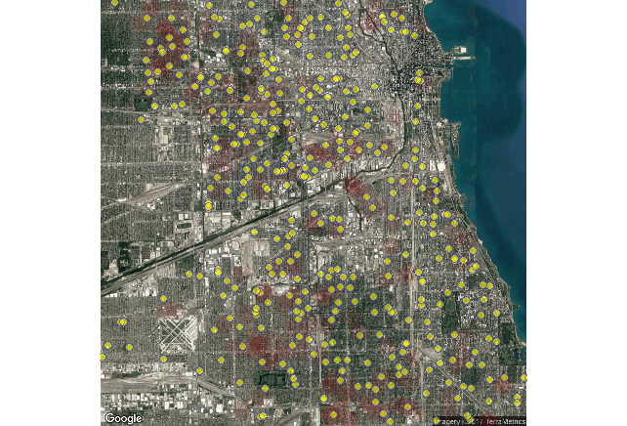
Total Arson Crimes in Chicago
This demonstrates the amount of Arson crime around the various schools
Blue Shade= Arson Crimes
Yellow Dots = Schools

Slide 17
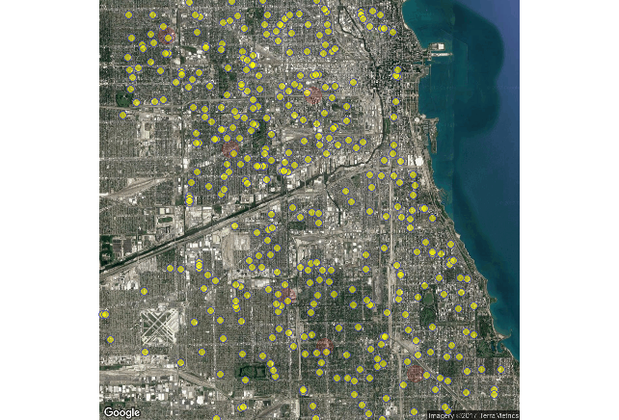
Total Homicide Crimes in Chicago
This demonstrates the amount of homicide around the various schools
Red Shade= Homicide Crimes
Yellow Dots = Schools

Slide 18
Understanding Our Client
Our team recognizes that there is crime everywhere. We also recognize that some families feel that are better equipped to tolerate certain types of crime over others. Some may say that they’d ‘rather live in a place where there is more theft than a place where there is a chance of homicide’ or a combination.
Our tools can be reapplied to find the safest place by your definition. We have also made our conclusion as well to help you define safety.

Slide 19
Recommendations

Slide 20
Recommendation
Throughout our careful analysis we have concluded the best ward to live in. Our conclusion is based upon the prediction of how likely there will be crime in the future. This does not compare the types of crime as we will leave that to our client to define safety.
The safest ward to line in with our prediction is ward 3.

